Slide 1

Big Mart
Sales Analysis

Slide 2
Objectives :
Analyzing the Sales Data and the influencing Attributes.
Insights for planning towards decreasing costs and Increasing Profitability.
Presenting the best predicting model.

Slide 3
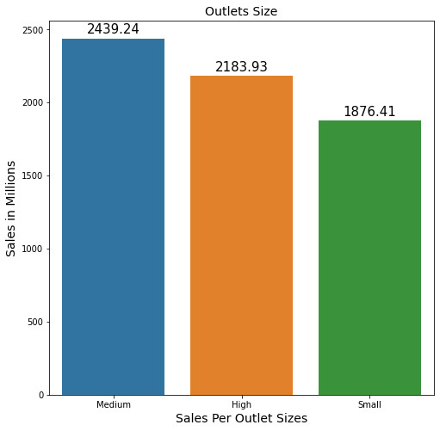
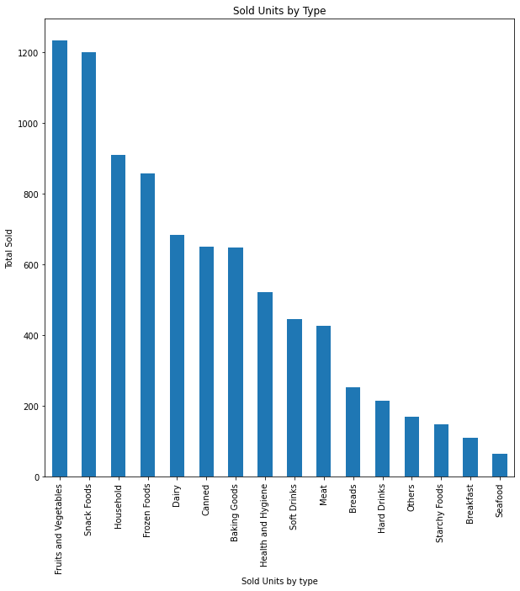
Sales Analysis by Outlet Size
The Analysis is showing that the most sales were sold by the medium size stores which can indicate that there is no need for expansion with big Size stores while medium Size stores can achieve more sales and less over head costs.
The second Chart is showing the most Sold Units which can help in finding Items that can be increased in the stores to increase profitability while decreasing the lowest sold Items.

Slide 4
Sales Prediction Models
While Applying the predicting Models the Linear regression Model scored better on the testing and training data sets better than the Decision Tree Regressor.
The r2 Scores are higher on the Linear Regression models than the Decision Tree model, although RMSE is high but at the same time, both figures are very close which means that the model was able to Learn and Present predictions.
 | Linear Regression
Metrics | Training Scores | Testing Scores
R2 | 0.5615 | 0.5671
RMSE | 1139 | 1092
 | Decision Tree
Metrics | Training Scores | Testing Scores
R2 | 1 | 0.1997
RMSE | 0 | 1485

